Slide 1
The Assignment problem
Brandon roos, Nathan Price, Nathan Blunkall

Slide 2

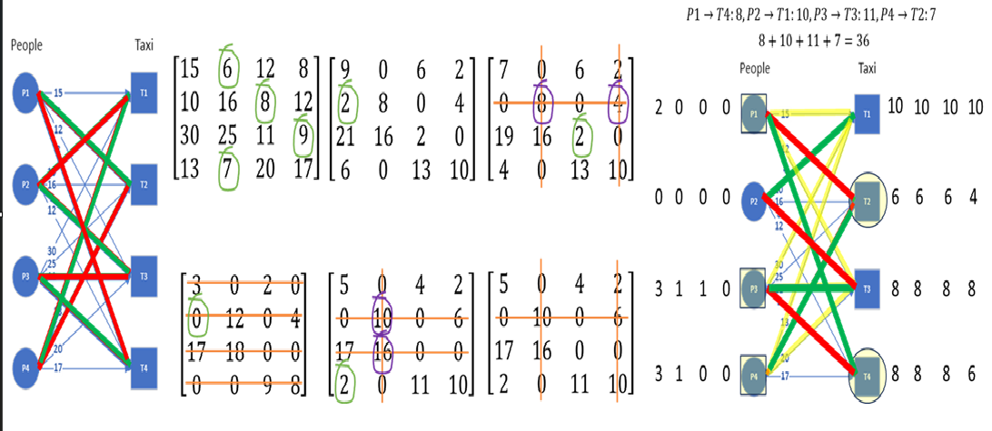
What is the Assignment problem?
The Assignment Problem describes the problem of assigning x number of agents to y number of tasks while incurring the lowest total cost possible. The Assignment Problem mainly uses a cost matrix or a bipartite graph as input and has many different methods to solve it.

Slide 3
What is the Assignment problem used for?
Personnel Scheduling
Task Assignment
Self Driving Cars
Facility Location and Workforce Planning

Slide 4
Solutions to the Assignment problem
Brute Force
Greedy
Hungarian
Max Flow Reduction

Slide 5
Objectives and questions
Our main objective in this project was to collect data on the execution time and basic operation count of the methods under a given input size, and to then compare these methods through empirical analysis of the results.
We naturally anticipated Brute Force to have the highest runtime and basic operation count.
We also wanted to prove the similarity in runtime between Maximum Flow Reduction and Hungarian through our results.
We questioned if the percentage error generated by the Greedy method correlated with the problem size or not.
We also anticipated Greedy to be the fastest due to its suboptimal results.

Slide 6
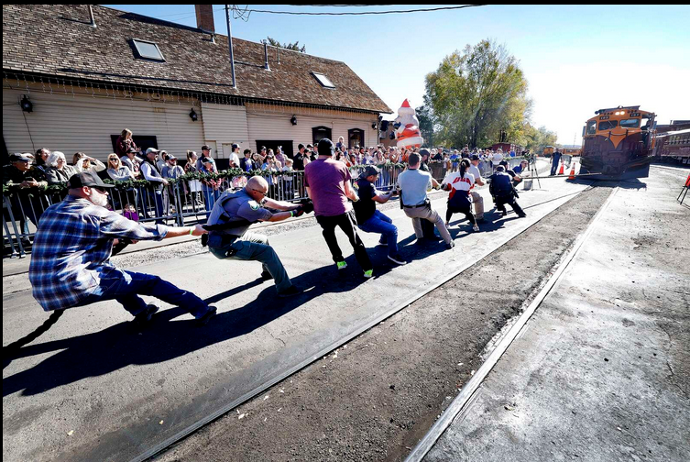
Pros and Cons of the Brute Force Solution
Pros:
Easy to implement
Guaranteed to find the optimal solution
Cons:
O(n!) running time
Only works for small problems due to its inefficiency

Slide 7
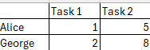

Pros and Cons of the Greedy solution
Pros:
Easy to implement
O(n*log(n)) running time
Cons:
Can pick suboptimal solutions
Only works for specific problems

Slide 8

Pros and Cons of the Hungarian solution
Pros:
Guaranteed to find the optimal solution
O(n^3) running time
Can handle infeasibility
Cons:
Harder to implement than the Greedy and Brute Force solutions
Requires a balanced cost matrix to work
Limited flexibility

Slide 9

Pros and Cons of the Max Flow solution
Pros:
Guaranteed to find the optimal solution
O(n^3) running time
Can be used to solve many variations of the assignment problem
Cons:
Hardest algorithm to implement
Only optimal for large complex problems

Slide 10
Experiment Description
All of our methods are written in Python and use artificial randomized datasets to generate our results. Our input sizes vary from 2 to 100 and take the form of a cost matrix. However, it goes from 2 to 9 for Brute Force, as it would be obscene to graph anything much higher than that. All of the algorithms were repeated five times.
Specifications of Test Computer:
OS: NixOS 25.05 (Linux)
CPU: Intel i7-10750h @ 5.00 GHz
GPU: NVIDIA GeForce RTX 3070 Mobile
RAM: 16 GB
Our reference method is the Brute Force method. We have the performance metrics in the form of graphs, which include the basic operation counts, the problem size, and the runtime depending on the graph. Brute Force is depicted in red, Greedy in green, Maximum Flow Reduction in blue, and Hungarian in yellow.

Slide 11
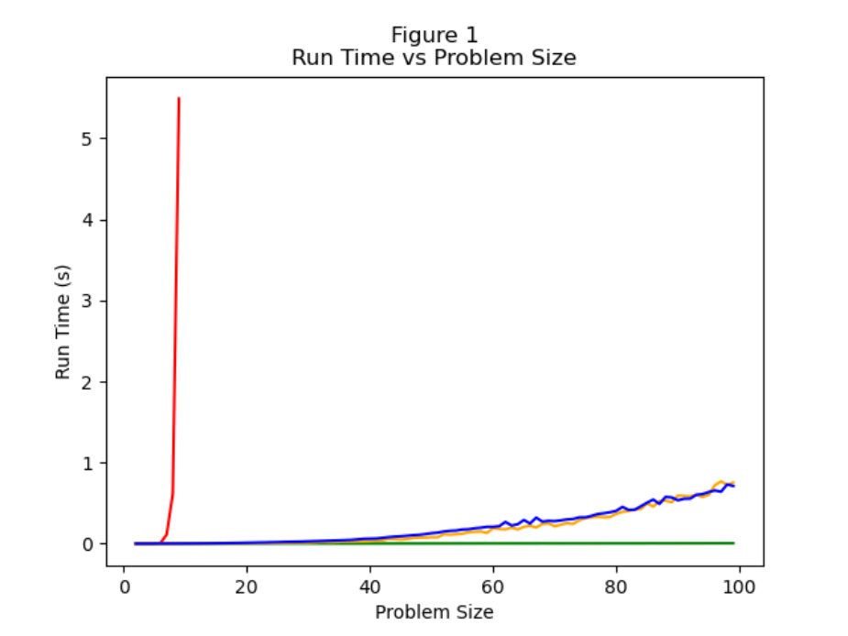
Our Results: Runtime With Brute Force
From the chart, we can see that the Brute Force method with its O(n!) running time is so inefficient with larger input sizes that it makes it nearly impossible to represent the other methods.

Slide 12
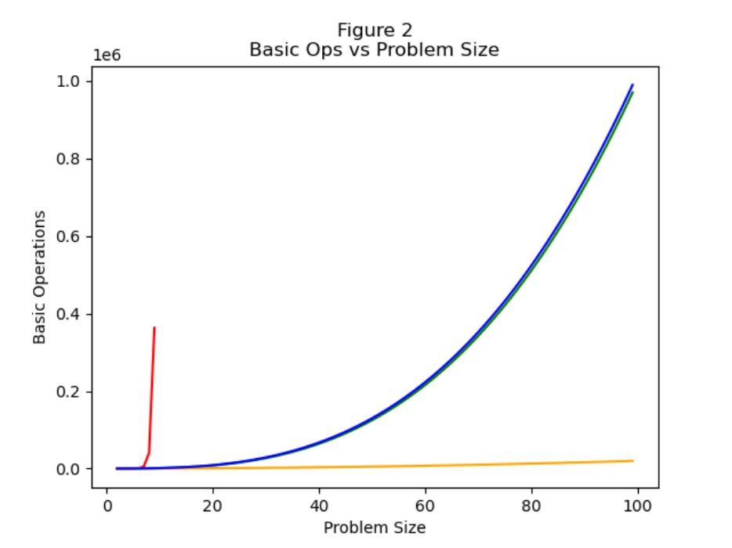
Our Results: Basic OpERATION Count With Brute Force
The Brute Force method again overwhelms the others in terms of the number of basic operations and was thus limited. We can see here that Hungarian has a massively lower number of basic operations, but from the previous graph, a similar execution time to Maximum Flow Reduction.

Slide 13
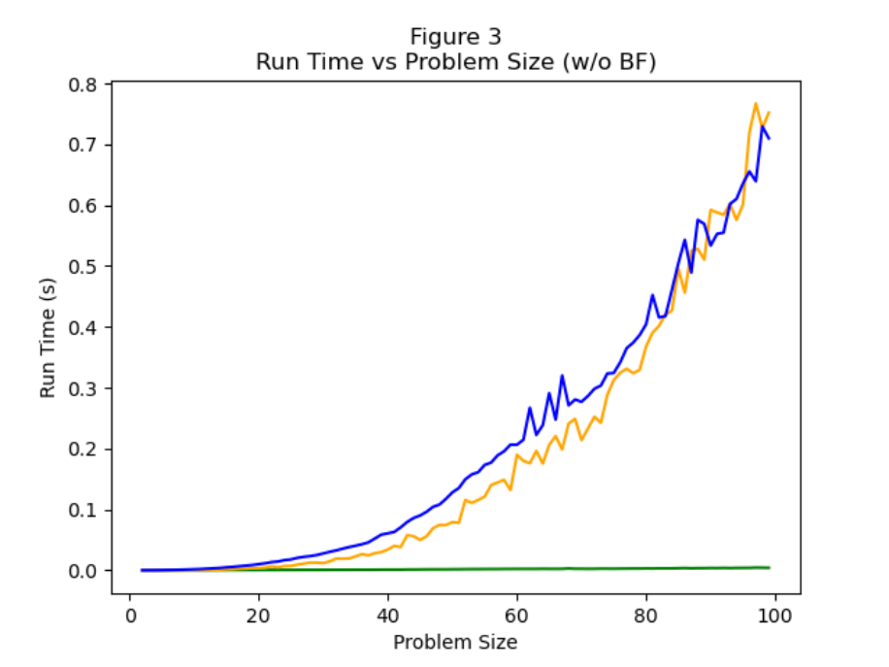
Our Results: RUNTIME without Brute Force
Without the Brute Force method, we can more clearly compare the other three algorithms. In these charts you can see that, in terms of runtime, we found that the Hungarian and Max Flow methods perform similarly while the Greedy algorithm runs faster. This shows our predictions to be accurate.

Slide 14
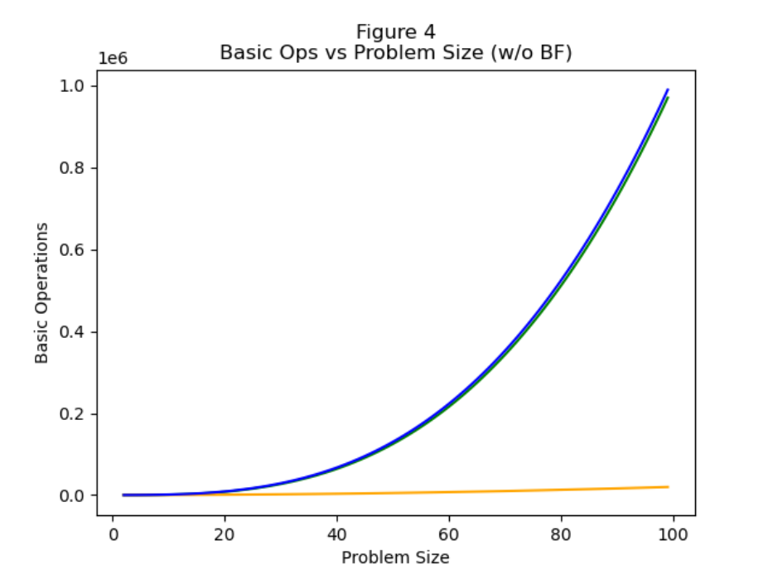
Our Results: Basic OpERATION Count without Brute Force
In terms of basic operations, we found that the Max Flow and Greedy methods have an extremely similar growth rate while the Hungarian algorithm had the lowest growth by far.

Slide 15

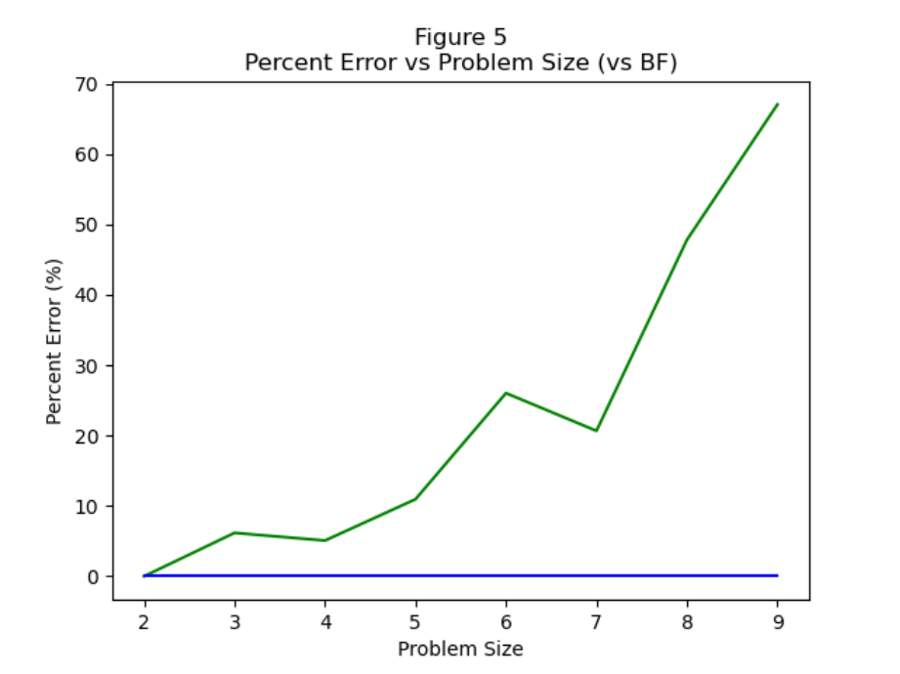
OUR RESULTS: %ERROR
In terms of percent error, this graph shows that as problem size increases, Greedy is the only one to trend upward versus the other methods relative to Brute Force.

Slide 16
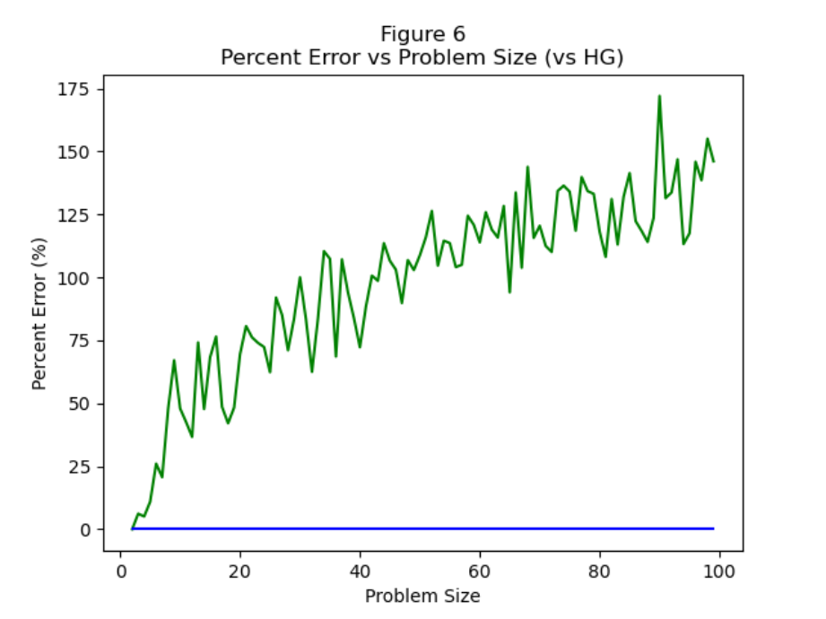
OUR RESULTS: %ERROR CONT.
This graph serves as an extension of the prior graph, encompassing a much larger problem size. The trend of increasing error with increasing input size for Greedy is much clearer here, while the others lay completely flat.

Slide 17
INTERPRETATION
In conclusion, we found that the four algorithmic solutions to the Assignment Problem have many pros and cons. We found that the Brute Force solution is extremely inefficient and shouldn’t be used outside of very small input sizes. We also found that while the Greedy solution is efficient, we’ve shown that it can include so much error, which detracts from its usefulness over larger input sizes, as well as the fact that it can produce suboptimal solutions. Finally, we found that the Hungarian and Max Flow solutions provide the best balance between runtime and basic operation count while both being guaranteed to produce optimal solutions. While both have a running time of O(n^3), the Hungarian Algorithm provides that solution with fewer basic operations and a generally comparable running time, resulting in it being the overall best performer in our tests.

Slide 18
LIMITATIONS
The main limitation in our experiments was the lack of knowledge towards the numpy package, which would have helped our coding process immensely. If we had to do it over again, numpy would have likely been a large help.
Another limitation was input size. We would have liked to have taken it even further than we did, but the computation would have just been impractically long.
There was significant noise in our running time data, and we believe that it was the garbage collector.

Slide 19
Next steps
We would try to further analyze the basic operation count of the Hungarian method versus the Maximum Flow Reduction method. This could have greater implications, and it raises interesting questions such as the relative power consumption between the two or other similar comparisons between the two methods.

Slide 20
Sources
“Assignment Problem and Hungarian Algorithm.” Top Website Designers, Developers, Freelancers for Your Next Project, www.topcoder.com/thrive/articles/Assignment%20Problem%20and%20Hungarian%20Algorithm. Accessed 30 Nov. 2025.
Cohen, Jeremy. “Exactly How the Hungarian Algorithm Works (Self-Driving Cars Example).” Read from the Most Advanced Autonomous Tech Blog, Read from the most advanced autonomous tech blog, 4 July 2025, www.thinkautonomous.ai/blog/hungarian-algorithm/.
Roberto Montemanni Department of Sciences and Methods for Engineering University of Modena and Reggio Emilia Reggio Emilia, et al. On Solving the Assignment Problem with Conflicts, arxiv.org/html/2506.04274v1. Accessed 30 Nov. 2025.
Sethuraman, Prasanna. “Optimum Assignment and the Hungarian Algorithm.” Towards Data Science, 18 Jan. 2025, towardsdatascience.com/optimum-assignment-and-the-hungarian-algorithm-8b1027628028/.

